Slide 1


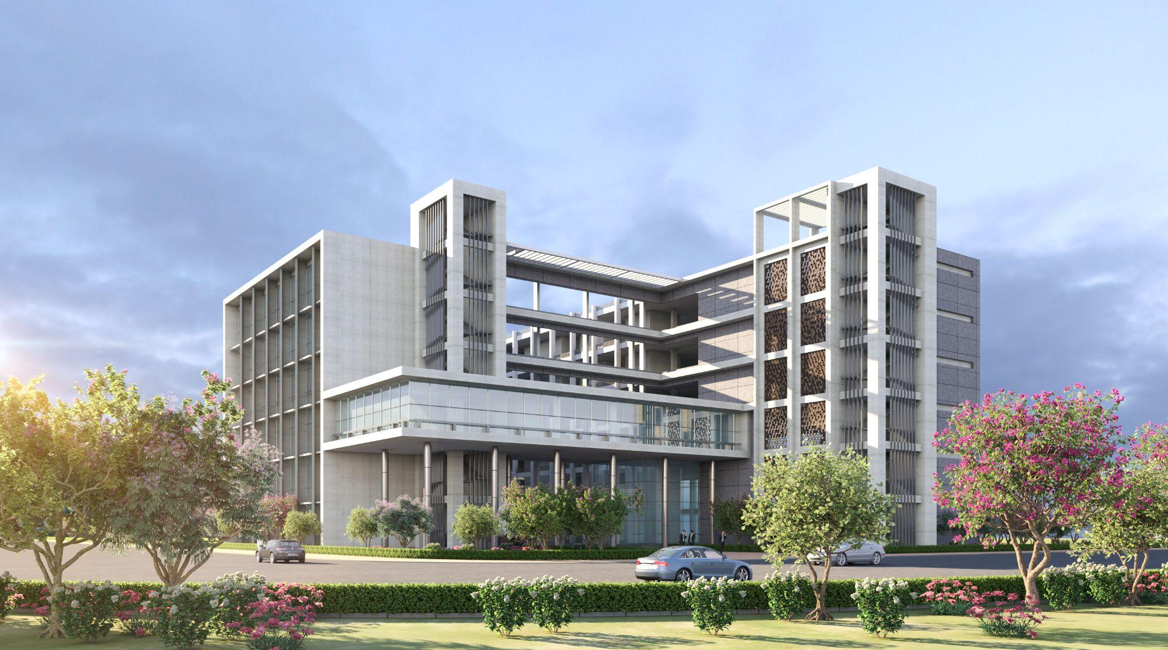
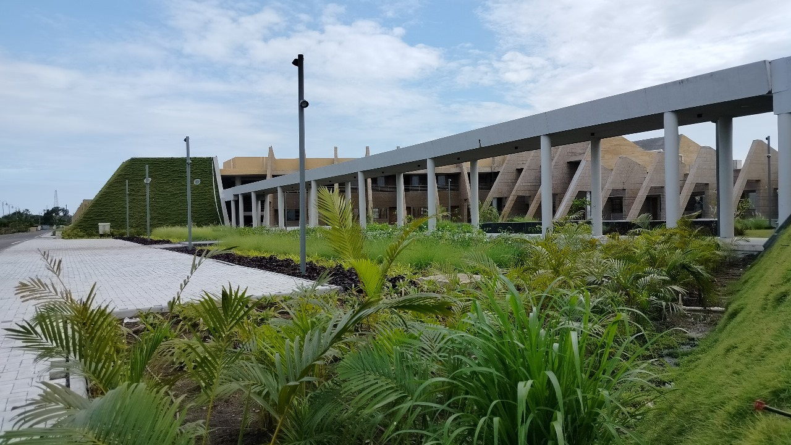

Indian Institute of Information Technology Vadodara
IIITV & IIITV-ICD

